Slide 1
Weighted Yield Report
Metric Outline and Plan

Slide 2
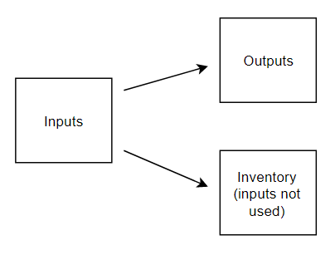
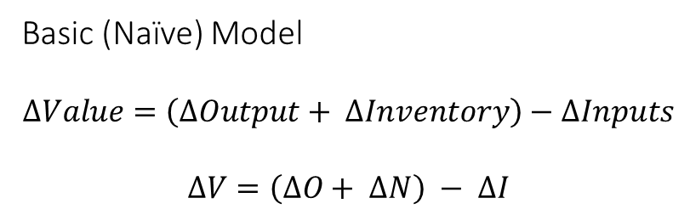
What is it?
Basic (Naïve) Model
$$∆Value=\left(∆Output+ ∆Inventory\right)−∆Inputs$$
$$∆V=\left(∆O+ ∆N\right) − ∆I$$
Metric that calculates costs of a system or process based on inputs and outputs to the system (yield)
Factors in value held by units that are input and not used (inventory)
Resulting metric is a change in value over a period of time

Slide 3
Normalizing the Model
Basic (Naïve) Model
$$∆Value=\left(∆Output+ ∆Inventory\right)−∆Inputs$$
$$∆V=\left(∆O+ ∆N\right) − ∆I$$
Either real values can be used, or the values can be normalized to a “unit value” of 1
Real values have problems in portraying accurate results
“Unit values” mean every unit is valued at 1
Notes:
Either real values or “unit values” can be used in the naïve model.
While real values could potentially provide us with real numbers, the model is ignorant to many outside costs such as labor and storage. The real values of input and output units become very hard to accurately estimate without details from outside the model, and are want to provide inaccurate results.
Instead, by considering every unit as a value of 1, we can retrieve results that suggest the costs of using the system, and the metric becomes a measure of the health of the system

Slide 4
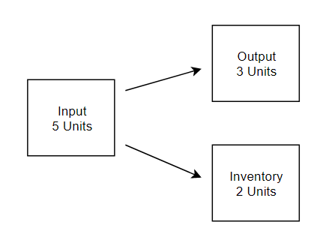
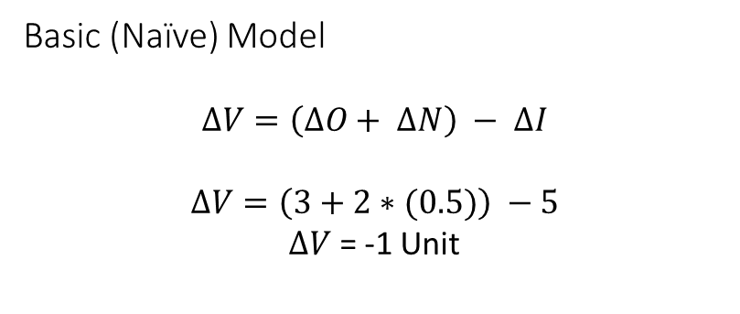
Normalizing the Model (Example)
Basic (Naïve) Model
$$∆V=\left(∆O+ ∆N\right) − ∆I$$
$$∆V=\left(3+2∗(0.5)\right) −5$$
$∆V$ = -1 Unit
Example: over a week, 5 units are added to the system, 2 fail and return to inventory, 3 are output
Assume units in inventory are less valuable
Model provides a calculation for how much value is lost from units input to the system
ΔV is always negative
  ΔV = 0 describes a perfect system
  The close ΔV is to 0, the healthier the system
Notes:
The normalized version of this model always provides a ΔV output that is negative, or at best, equal to 0
ΔV in essence represents the costs associated with adding units to a system over a period of time, in terms of how many of those added units actually get used

Slide 5
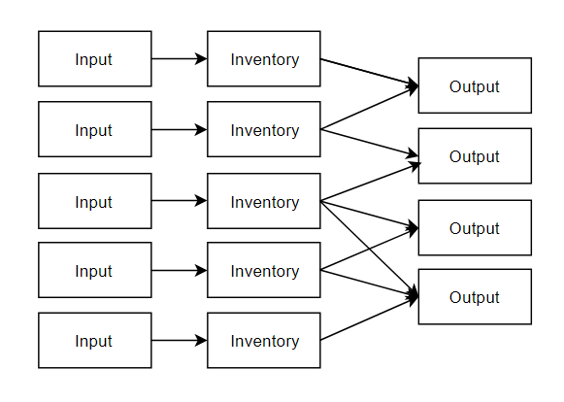

A Less Naïve Model
Overall Equation Still True
$$∆V=\left(∆O+ ∆N\right) − ∆I$$
A more complete model considers that inputs can have multiple outputs
All units are added to an inventory, before being used for output
How many units can leave inventory is related to how many orders of output are received
Notes:
In a less naïve model we consider that multiple inputs/inventories are competing to fulfil the same outputs.
The number of units that can actually leave inventory is limited by the orders for a given output. We don’t need to directly factor this into the calculation of ΔV necessarily (though we may see it in later equations), but it does influence ΔO and ΔN. For example, if we hold ΔI constant (e.g. 50 units come in weekly, no matter what), but the number of orders goes down, then ΔO decreases (less orders fulfilled), while ΔN increases (units get added to inventory, but also depreciate in value over time) and overall, ΔV becomes more negative.
In other words, a decrease in orders without adjustment on input leads to a more negative ΔV, indicating worse health of the process.

Slide 6
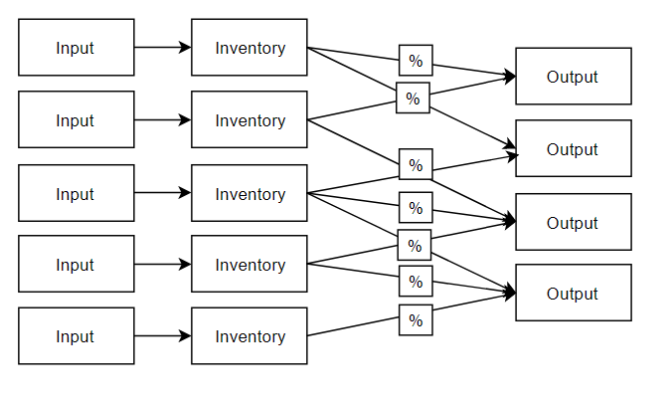
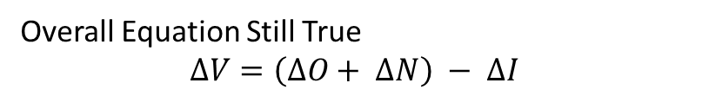
An Even Less Naïve Model
Overall Equation Still True
$$∆V=\left(∆O+ ∆N\right) − ∆I$$
We also consider that not all units that try to leave inventory are successful
Adding this in begins to give us a better sense of how value of the inventory decreases over time
ΔO and ΔI are still the same
So how to find ΔN…?
Notes:
This now shows a more realistic model of how units are used.
The % chance for a unit in inventory to output gives us an idea of how inventory value decreases over time. If a unit doesn’t get selected for output, it stays in inventory. It might stay in inventory because it failed a test already, or just because it isn’t selected. In any case, over time the chance for it to become an output decreases, and so its value decreases, hence the entire inventory value decreases over time.

Slide 7
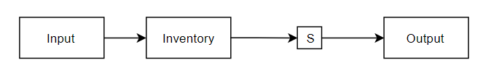

Inventory Value
Overall Equation Still True
$$∆V=\left(∆O+ ∆N\right) − ∆I$$
Call pass rate S for Success
Example 1:
Consider a fresh input and empty inventory
S = 0.5
Example:
Notes:
Example 1:
When a fresh unit comes in, it comes in with a value of 1. It cannot decrease in value just for existing in the inventory, because it is still the same unit that just came in
If it passes the 50% test, it becomes an output with a value of 1. ΔV = 0

Slide 8
Inventory Value

